Slide 1

Warrior Club - Web Design Project
This presentation outlines the web design project for Warrior Club. It covers design, structure, and styling using HTML and CSS. We aim to create an informative, visually appealing, and user-friendly website.
NAME: ADITYA KUMAR
UID: 24BCA10139

Slide 2

Project Planning & Design
Website Structure
Home, About Us, Membership, Events, and Contact pages were planned.
Design Mockups
Initial sketches and wireframes laid out the visual framework.
Branding
A colour palette and typography were selected to define the brand.
Navigation
A simple, intuitive user flow ensures ease of navigation.

Slide 3

index.html - Structure (Part 1)
Basic Structure
Meta Tags
The basic HTML structure includes ``, ``, ``, and `` tags.
Meta tags set the charset and viewport for responsiveness.
Title Tag
The title tag is set as ``.

Slide 4
index.html - Content (Part 2)
Main Section
About Section
The `
About section briefly describes the club's purpose and values.
` tag houses the primary website content.
Events section displays a list of upcoming events for members.
Hero section introduces with image and call-to-action button.

Slide 5
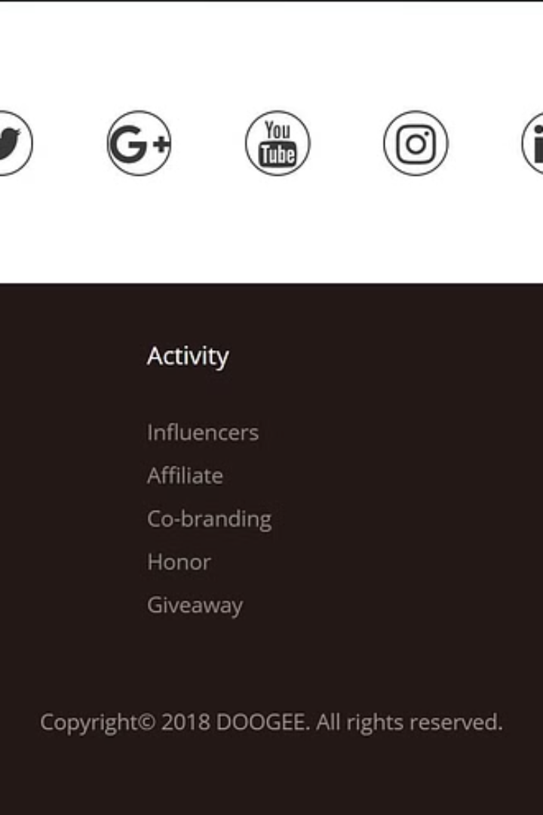


index.html - Content (Part 3)
Footer Section
Linking Styles
Copyright information, contact details, and social media links are added.
Stylesheet is linked using `` in ``.

Slide 6
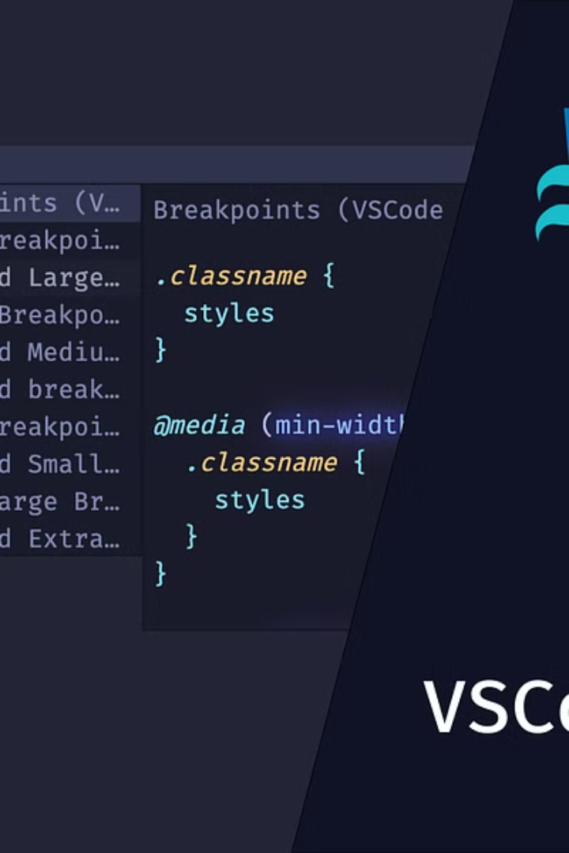



styles.css - Styling (Part 1)
CSS Reset
Resets default browser styles for consistency.
Global Styles
Defines body font, background, and text colour.
Header Styling
Sets logo size and navigation menu layout.

Slide 7
styles.css - Layout (Part 2)
Main Content
1
Padding and heading styles applied.
Hero Section
2
Background image and text positioning.
Event Section
3
Grid/Flexbox layout for event cards.

Slide 8



styles.css - Responsiveness
Mobile-First
2
Starts with mobile styles and scales up.
Media Queries
Adapts layout for different screens.
1
Navigation Menu
3
Adjusts for mobile screens (e.g., hamburger menu).

Slide 9



Conclusion & Enhancements
1
Summary
2
Improvements
3
Challenges
The Warrior Club website was successfully designed. Future improvements include adding JavaScript for interactivity. SEO optimisation and more dynamic content are also planned. Challenges were faced during design.

